Slide 1
RADIO FREQUENCY IDENTIFICATION (RFID) FOR LIBRARIES
By
Vinod Kumar Mishra Assistant Librarian , BP Central Library, NIT Rourkela, Odisha-769008, India Email : mishravk79@gmail.com
Mobile: +919439420860

Slide 2
What is RFID ?
Radio-frequency identification (RFID) uses electromagnetic fields to automatically identify and track tags attached to objects. The tags contain electronically stored information. Passive tags collect energy from a nearby RFID reader's interrogating radio waves. Active tags have a local power source such as a battery and may operate at hundreds of meters from the RFID reader.
Notes:
Source : https://en.wikipedia.org/wiki/Radio-frequency_identification

Slide 3
Usage of RFID in libraries
RFID
Self Issue
Self Return
Book drop
Theft detection
Stock verification
Member query
Book query

Slide 4
Hardware components of RFID
RFID tags/ transponder
Readers or Sensors to query the tags/Interrogator
Antenna
Book Drop
Self-issue/return KIOSK
Shelve reader/Handheld Reader
Security (EAS) gate
Member Card

Slide 5
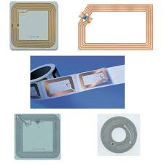
RFID tags/ transponder
There are two types of RFID tag HF (High Frequency) and UHF (Ultra High Frequency) with varying data storage capacity and operating frequency
Notes:
Source : https://www.google.co.in/search?q=rfid+tags+library&client=firefox-b&biw=1366&bih=604&source=lnms&tbm=isch&sa=X&sqi=2&ved=0ahUKEwjv4q2nyeLQAhXMvI8KHZrZCaEQ_AUIBigB#imgrc=mmOhjweSEsAvvM%3A

Slide 6
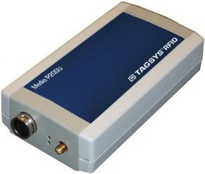
Readers or Sensors to query the tags/Interrogator
Notes:
Source : http://www.tagsysrfid.com/en-EN/products/download-catalog

Slide 7
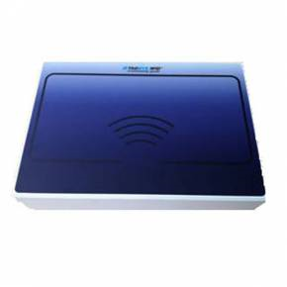
Antenna
Notes:
Source : http://www.tagsysrfid.com/en-EN/products/download-catalog

Slide 8
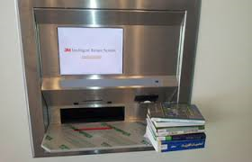
Book Drop
Notes:
Source: https://www.google.co.in/search?q=rfid+tags+library&client=firefox-b&biw=1366&bih=604&source=lnms&tbm=isch&sa=X&sqi=2&ved=0ahUKEwjv4q2nyeLQAhXMvI8KHZrZCaEQ_AUIBigB#tbm=isch&q=book+drop+library&imgrc=2QWFacV-MSipOM%3A

Slide 9
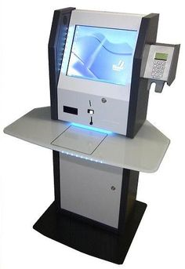
Self-issue/return KIOSK

Slide 10
Shelve reader/Handheld Reader

Slide 11
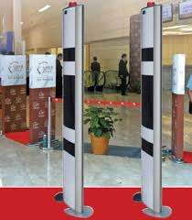
Security (EAS) gate

Slide 12
Member Card Specification
Notes:
Source : http://www.tagsysrfid.com/var/uploads/documents/53ea1b01218ae408c7ef9967e0af90f442fdeb1356dee.pdf

Slide 13
RFID System Work Environment
Notes:
Source : https://www.google.co.in/search?q=rfid+tags+library&client=firefox-b&biw=1366&bih=604&source=lnms&tbm=isch&sa=X&sqi=2&ved=0ahUKEwjv4q2nyeLQAhXMvI8KHZrZCaEQ_AUIBigB#tbm=isch&q=rfid+reader+library&imgrc=tlpCk5-6tMPesM%3A

Slide 14
Benefits of RFID In Libraries
Fast check-in/check-out of Library households.
Increased security of library materials.
Self-check-in/check-out facility to patrons
Long life of RFID tags in comparison to Bar-code
Fast stock verification
Save the wastage of time and man power to the library
Ability to locate/search the misplaced books in the library
Enhance reputation of the library and its services

Slide 15
Drawback of RFID In Libraries
Implementation of RFID system may be high-cost affair for small libraries
Security may be cracked by placing aluminum foil, magnet and wrong alignment of two tags in books.
Maintenance of RFID devices is very sophisticated and much more economic.
RFID devices need some basic infrastructure for more effectiveness like wooden rack/shelves, proper electric wiring beyond RFID devices, etc.
Proper ventilation and controlling of moisture need to be maintained in the libraries.
Due to lack of standards in RFID system changing the RFID vendor is very difficult.

Slide 16
QUESTIONS ?
THANK YOU

